Slide 1



Analyzing China & US. Economic Relationships with Singapore Markets

Slide 2
Motivations

Slide 3
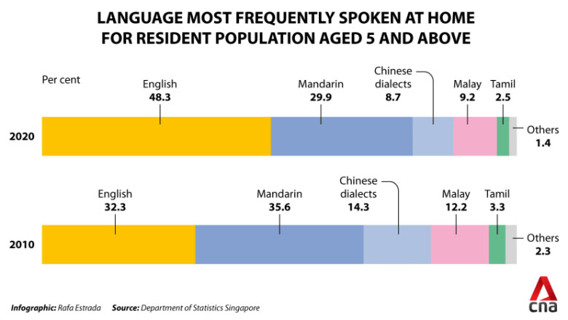
Motivations - Split Relationship - Cultural Ties

Slide 4
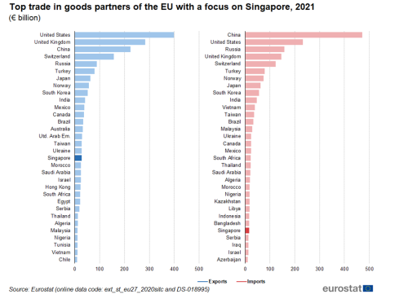
Motivations - Split Relationship - Strong Economic Ties

Slide 5
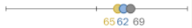

Motivation - Split Relationship - Singapore’s Favorability Ratings
18-29
Views of China
Views of US
30-49
50+

Slide 6
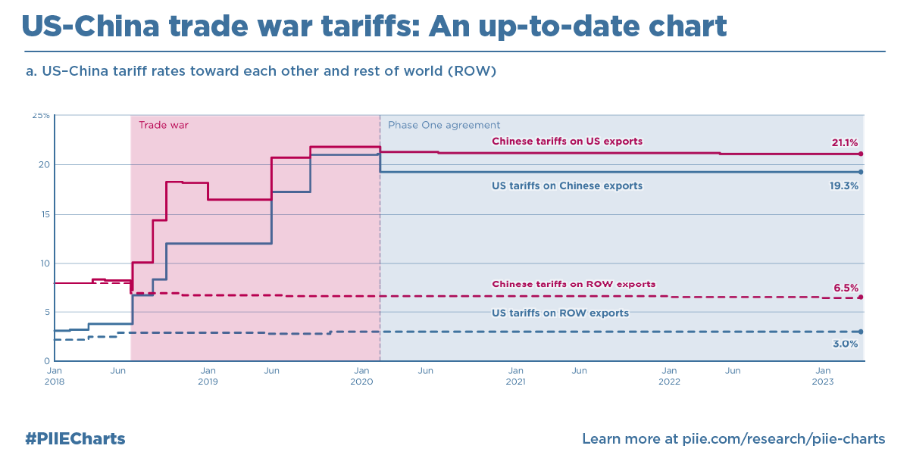
Motivation - Tensions - High Trade Tensions

Slide 7
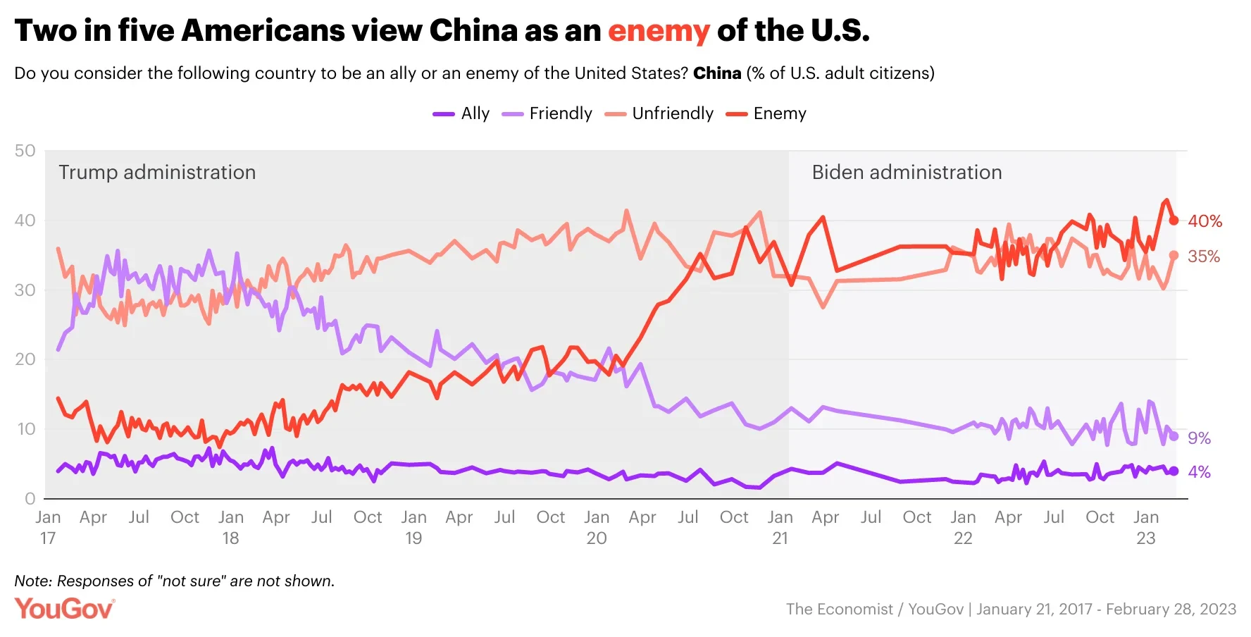
Motivation - Tensions - US Hostile view of China

Slide 8
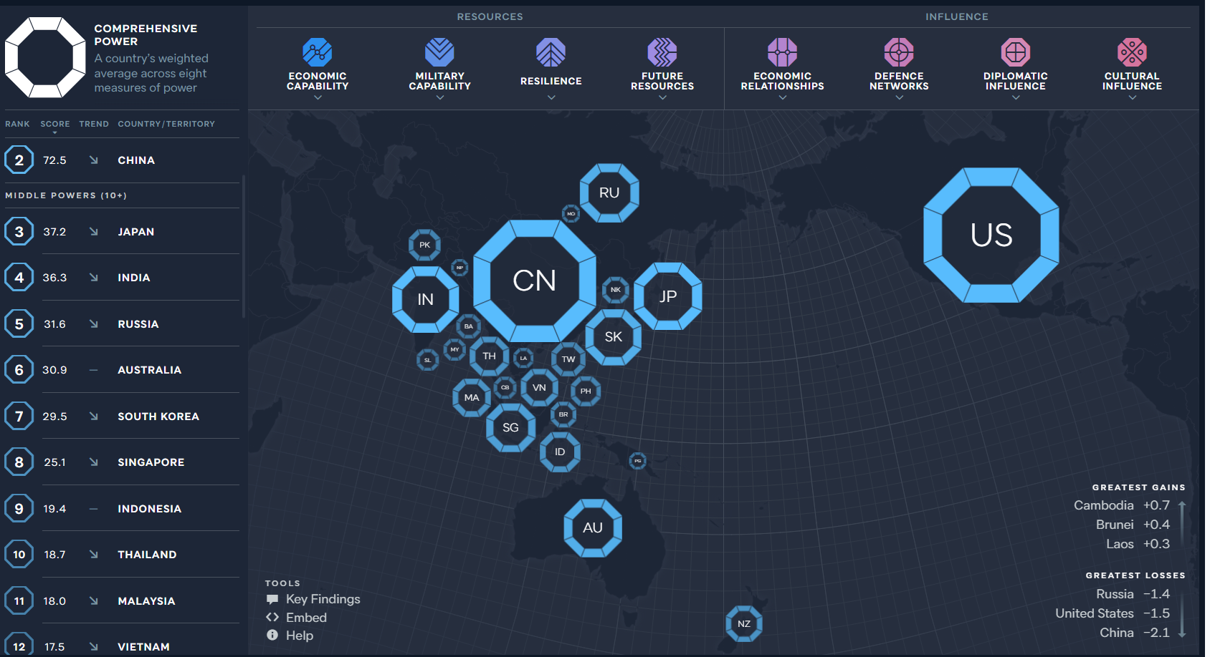
Motivations - Middle Powers Stuck In Middle

Slide 9
Research Question
Which Superpower economy (U.S. or China) has a greater relationship with Singapore Financial Markets ?

Slide 10
Hypothesis
H0: The United States & China’s Economies have near equal relationship on Singapore’s markets.
H1: One superpower’s economy has a more substantial relationship with Singapore’s markets.
Notes:
Some people studies null hypotheses

Slide 11
Literature Review

Slide 12
Theory & Literature Review
Stock Market Linkages between the Asean Countries, China and the US: A Fractional Integration/cointegration Approach - 2021
Fractional Cointegration over a series of asian countries between China & the US
Focused on general stock market & financial indices.
Found closer long term relationship with United States

Slide 13
Exploring Data

Slide 14
Exploring Data - Description of Data
Singapore
STI: Singapore FTSE Strait Times Index (Investing.com)
United States
SPY: S&P 500 Prices (Investing.com)
US Interest Rates: Discount Rate (FRED)
Production Index United States: Production: Industry: Total Industry Excluding Construction for United States (FRED)
USD: How many Singapore dollars are needed to purchase a US Dollar (Investing.com)
China
SHG: Shanghai Composite Index Prices
Chinese Interest Rates: Discount Rate (FRED)
Production Index China: Production: Industry: Total Industry Excluding Construction for United China (FRED)
CNY: How many Singapore dollars are needed to purchase a Chinese Yen

Slide 15
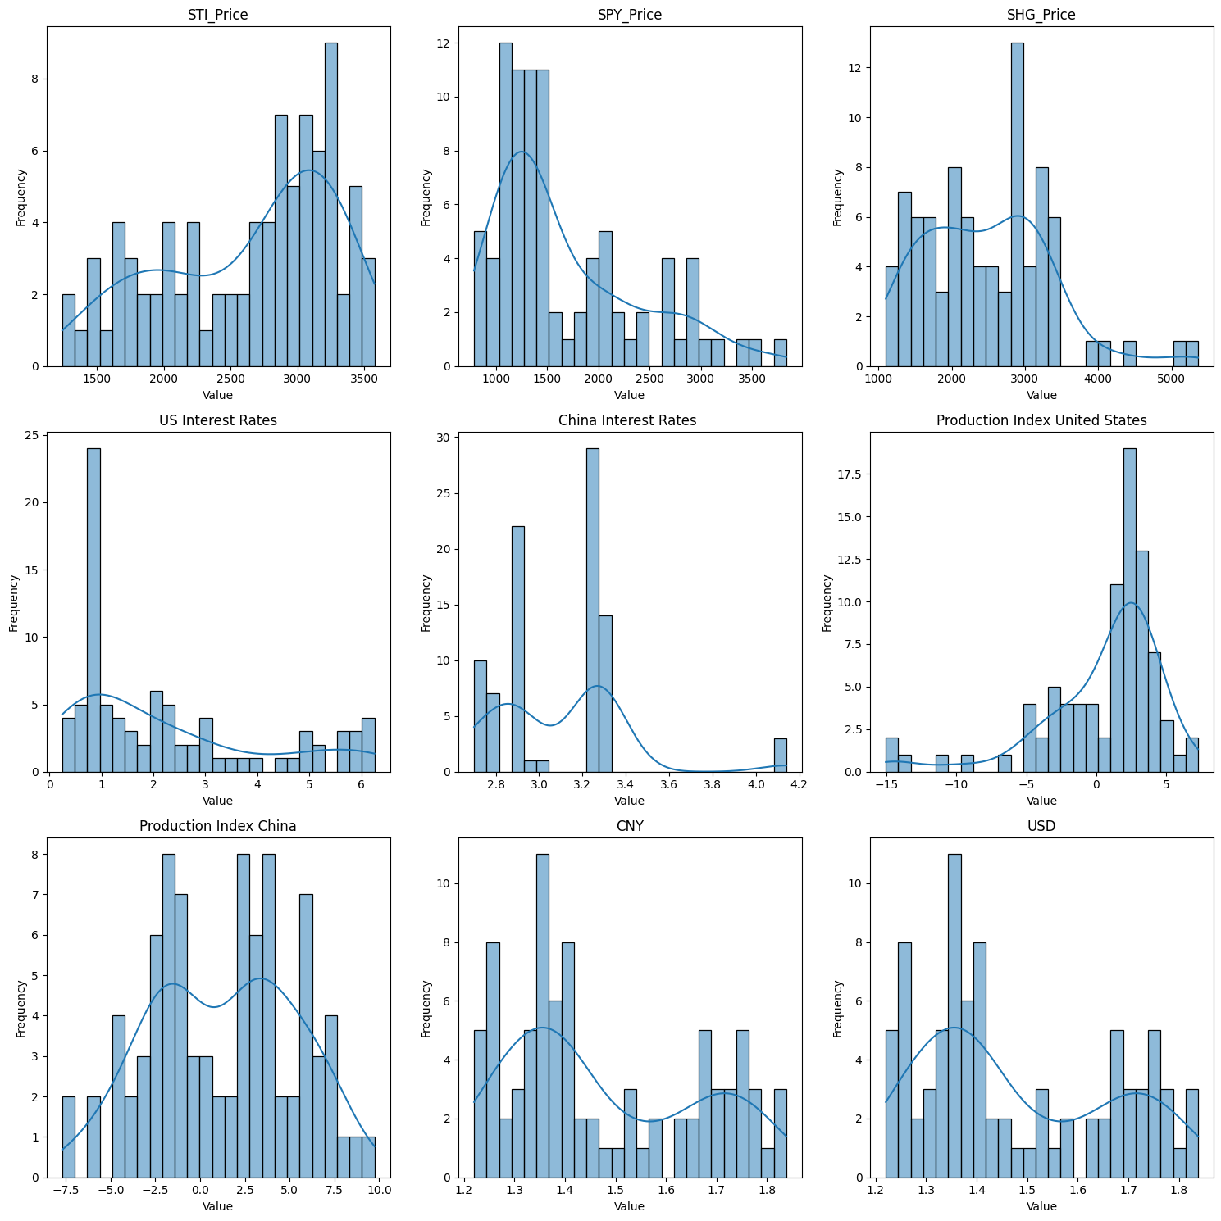
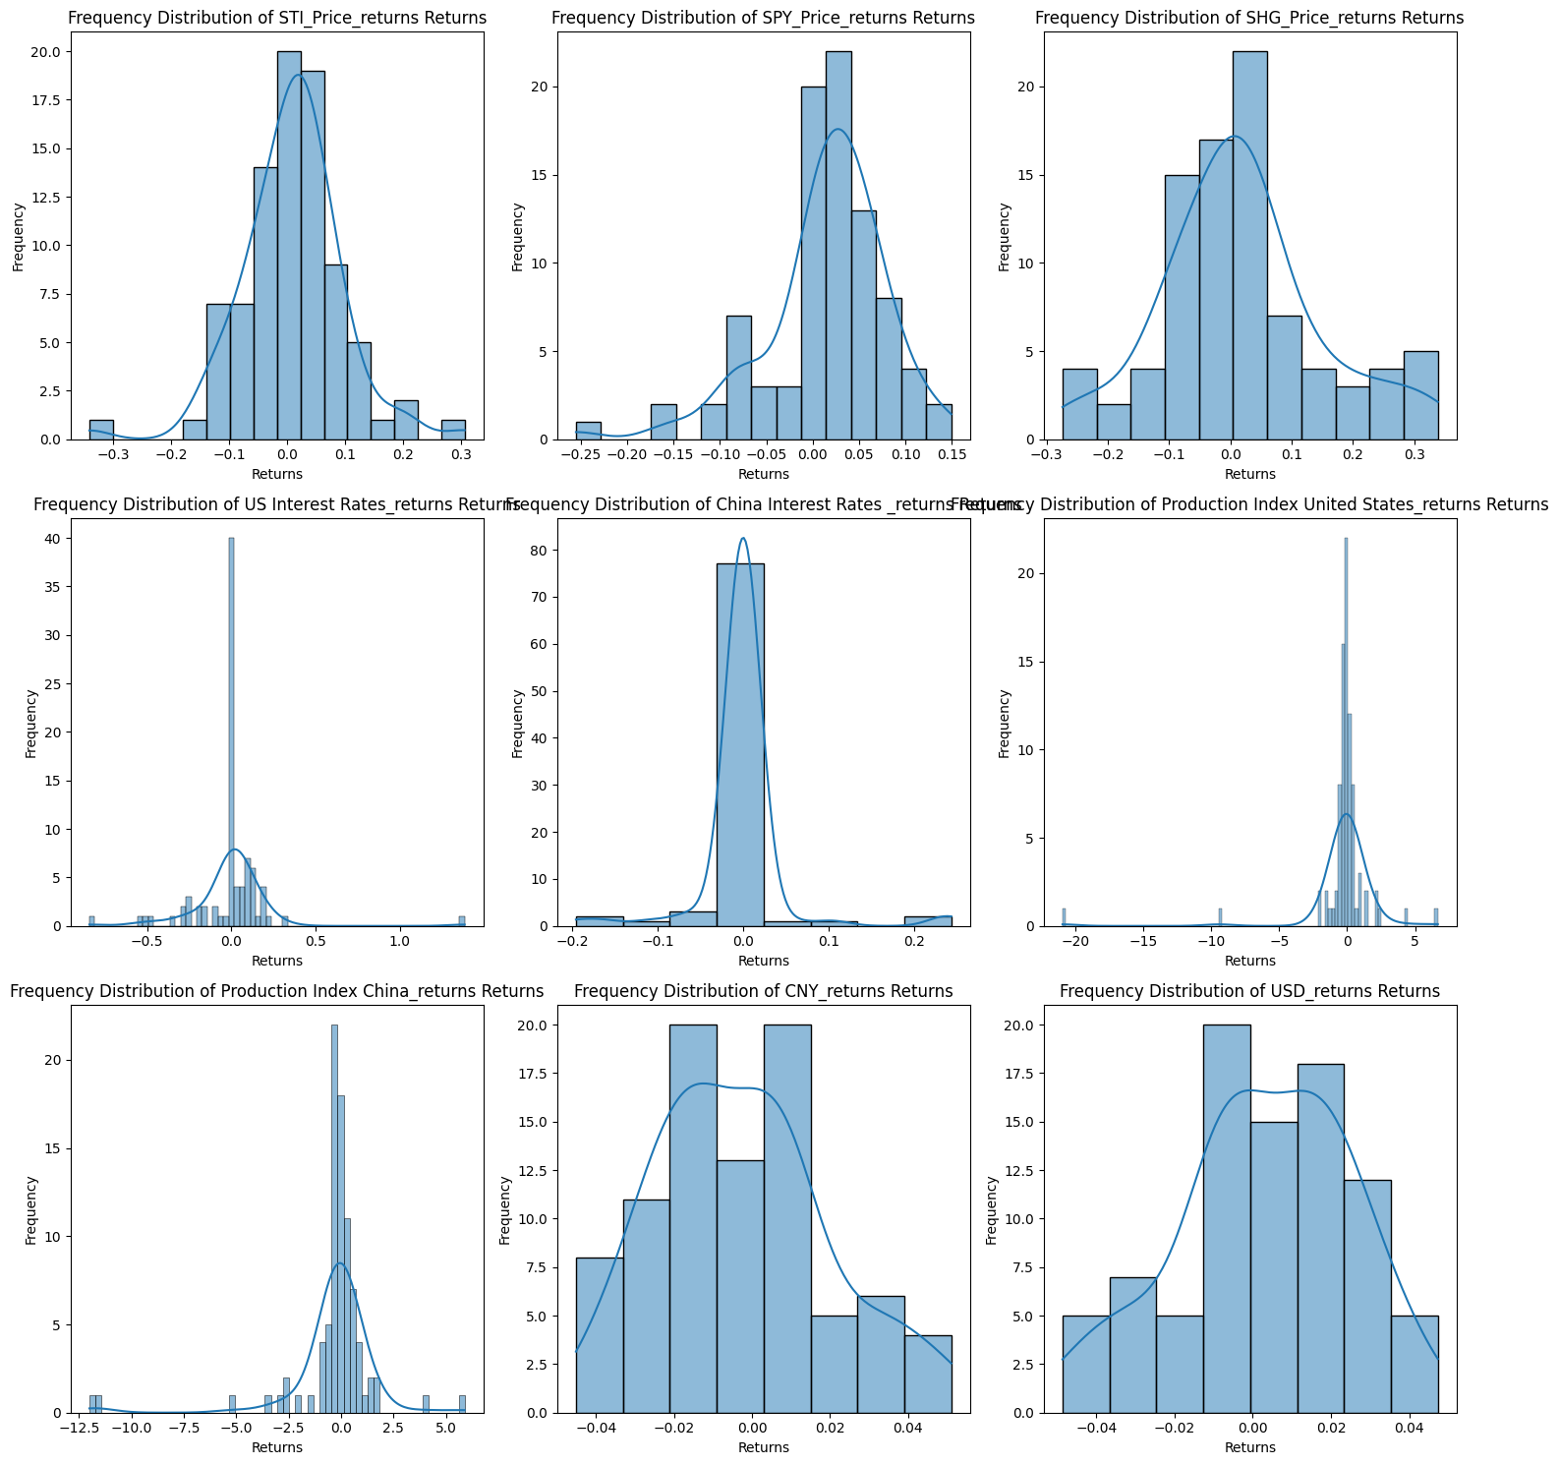
Exploring Data - Analysis - Frequency Distributions

Slide 16
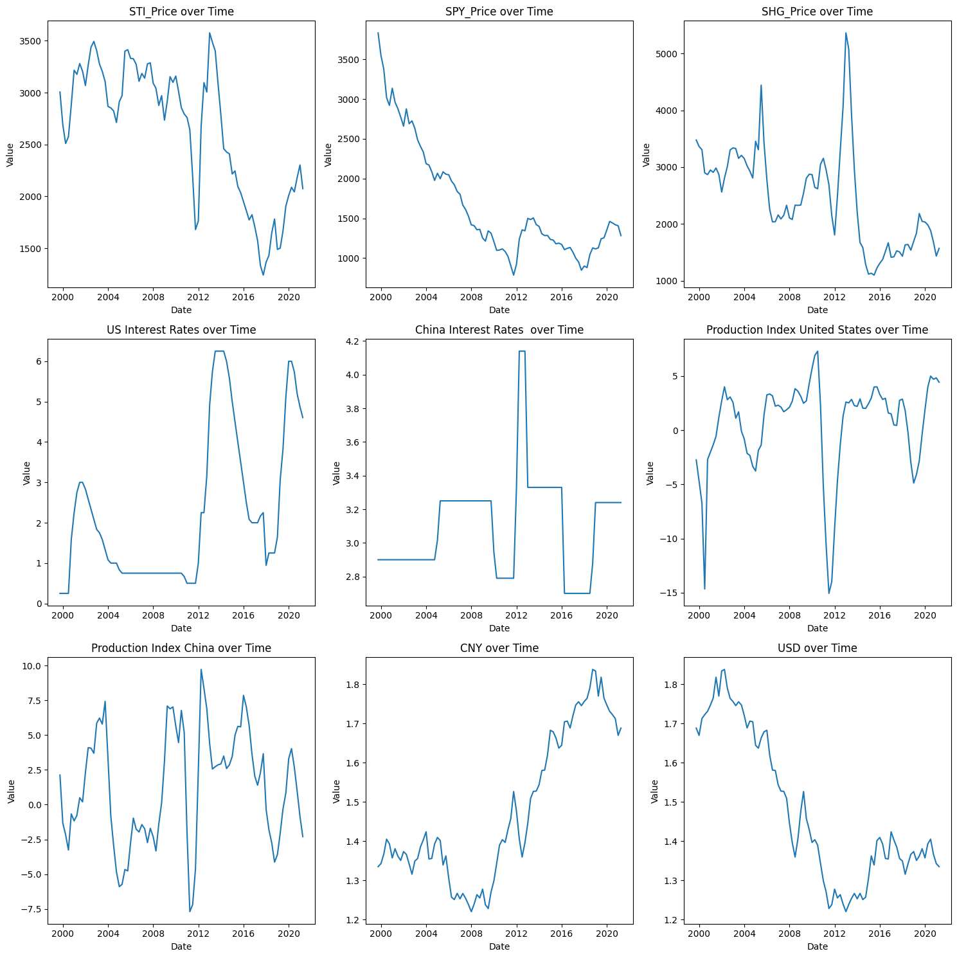
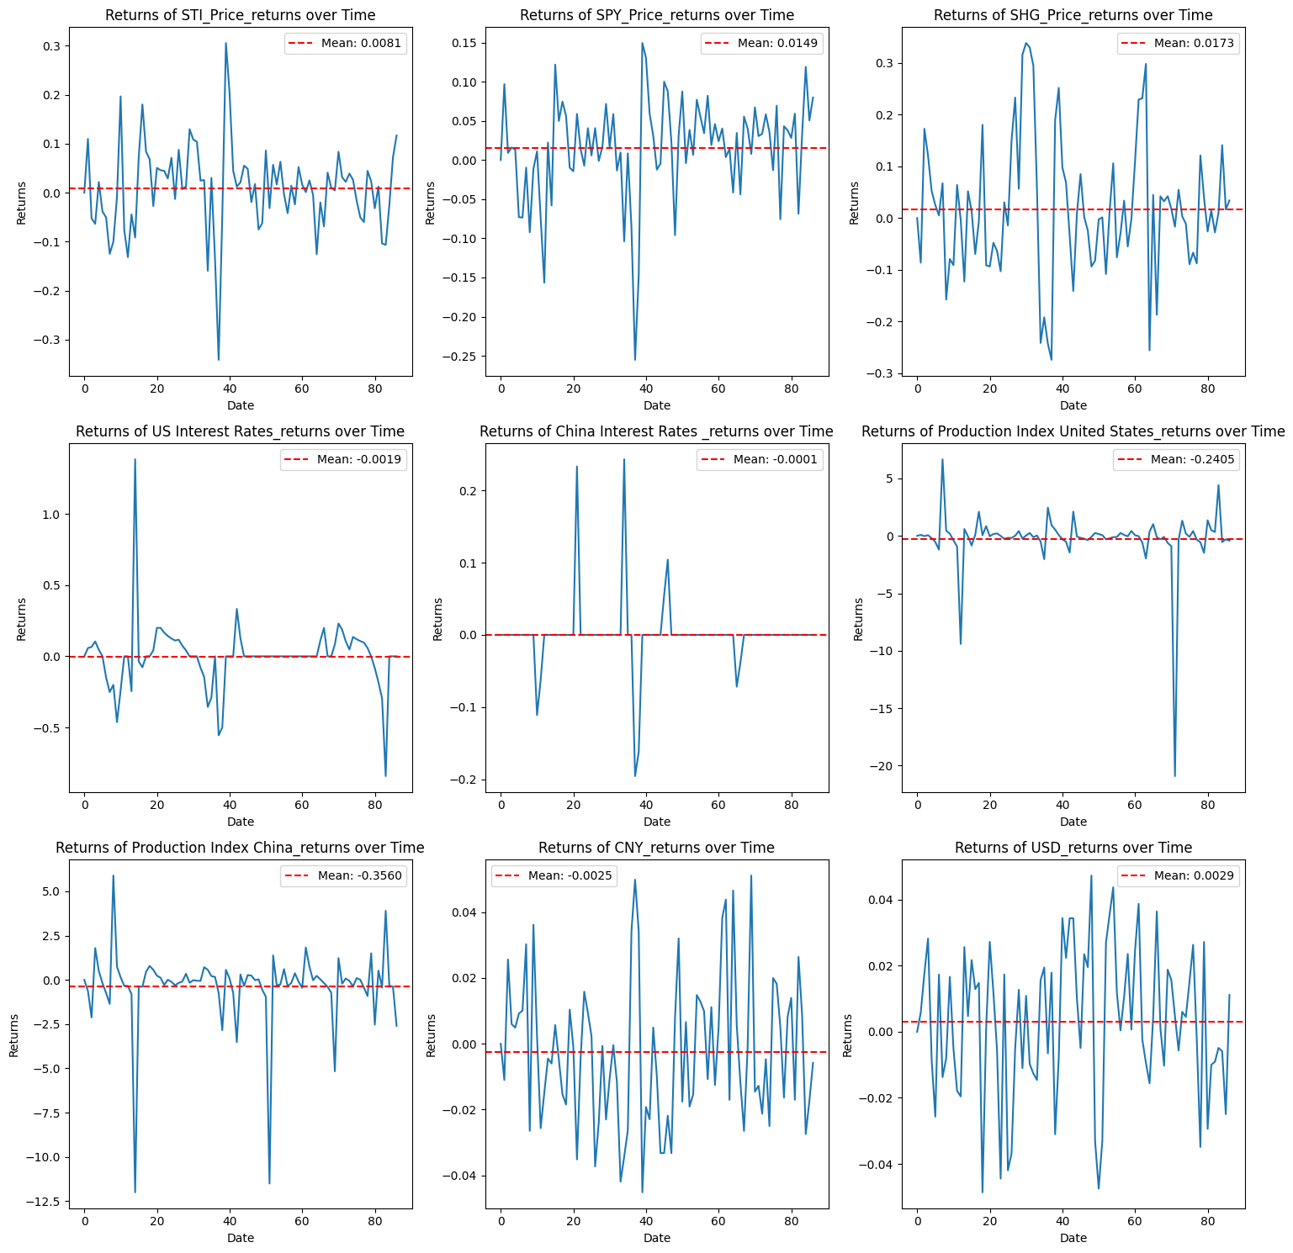
Exploring Data - Analysis - Over Time

Slide 17
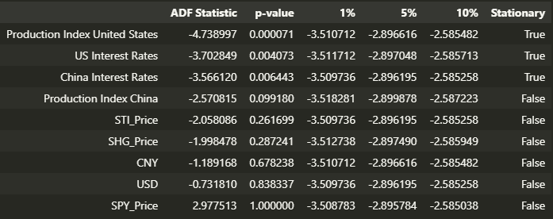
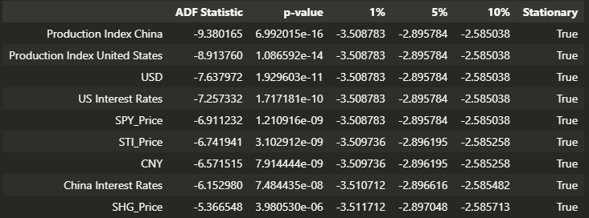
Exploring Data - Analysis - Unit Root Tests
Raw Data
Returns
Notes:
Include Autocorrelleation

Slide 18
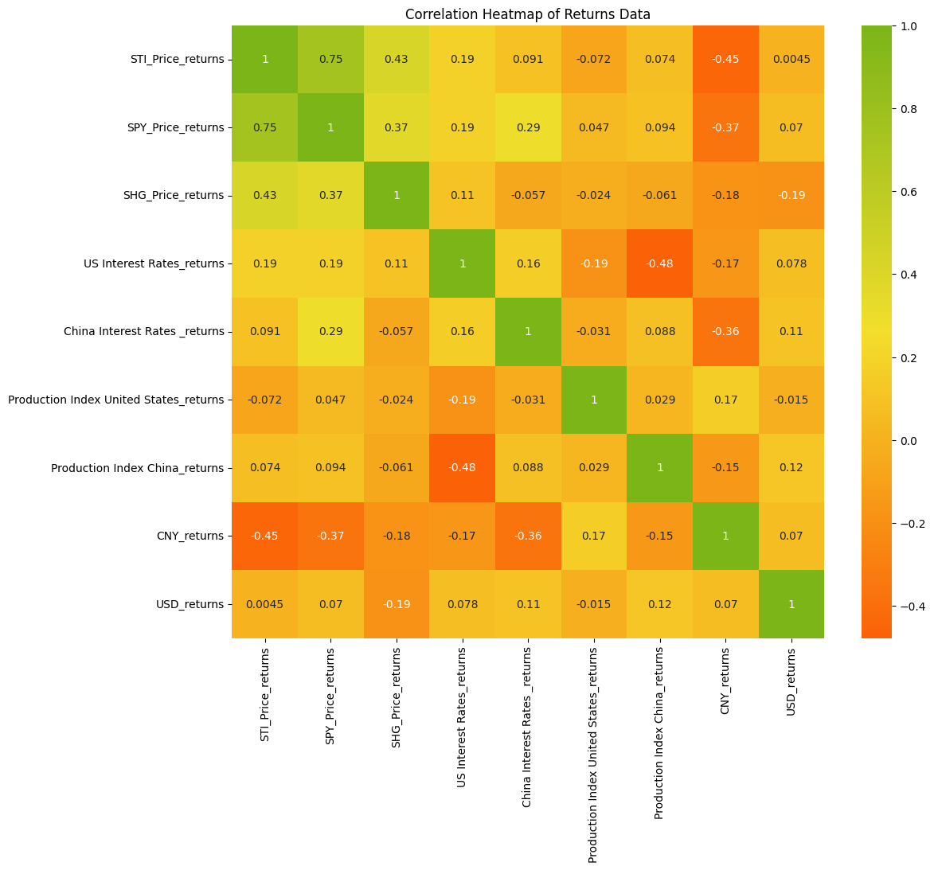
Exploring Data - Cross Correlations - Returns Data

Slide 19
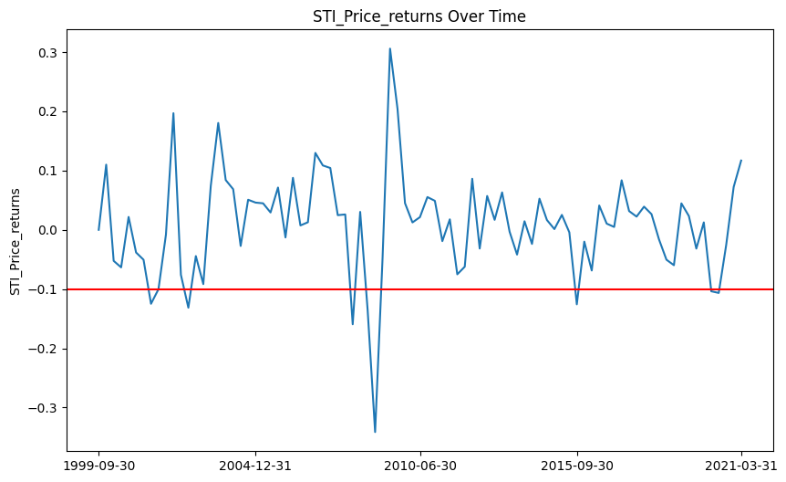
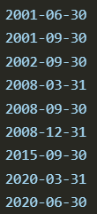
Exploring Data - Crisis Variable
Crisis Quarters:
Internet Crash
2008 Financial Crisis
China 2015 bubble
Covid

Slide 20
Research Methodology
& Research

Slide 21
Research - Research Methodology
Steps:
Cointegration Analysis
VEC Models
Granger Causality Tests
Impulse Response
Variance Decomposition

Slide 22

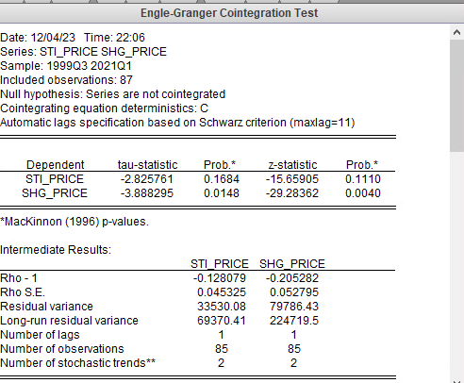
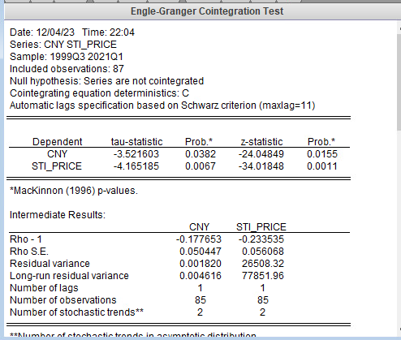
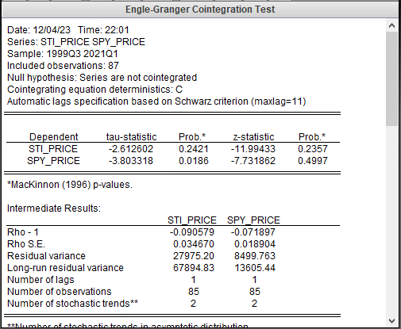
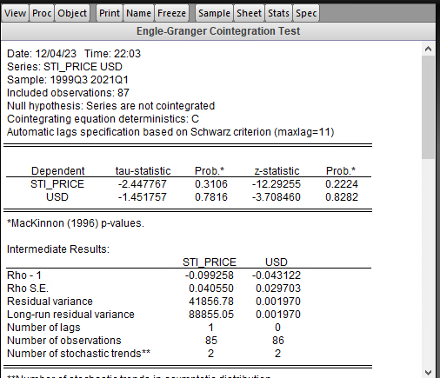
Research - VEC Analysis - Cointegration Analysis

Slide 23

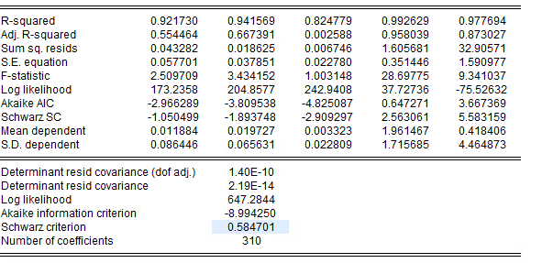

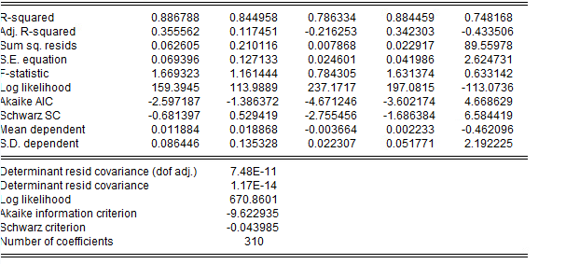
Research - VAR Analysis - Crisis Dummy Variables Lag-12

Slide 24
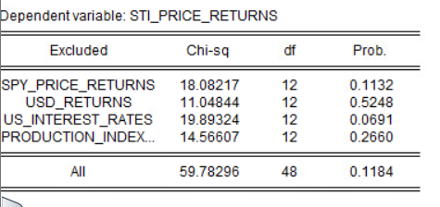
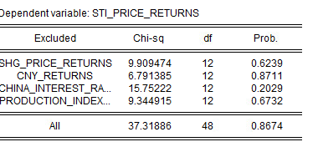
Research - VAR Analysis - Engle Granger Causality Test

Slide 25
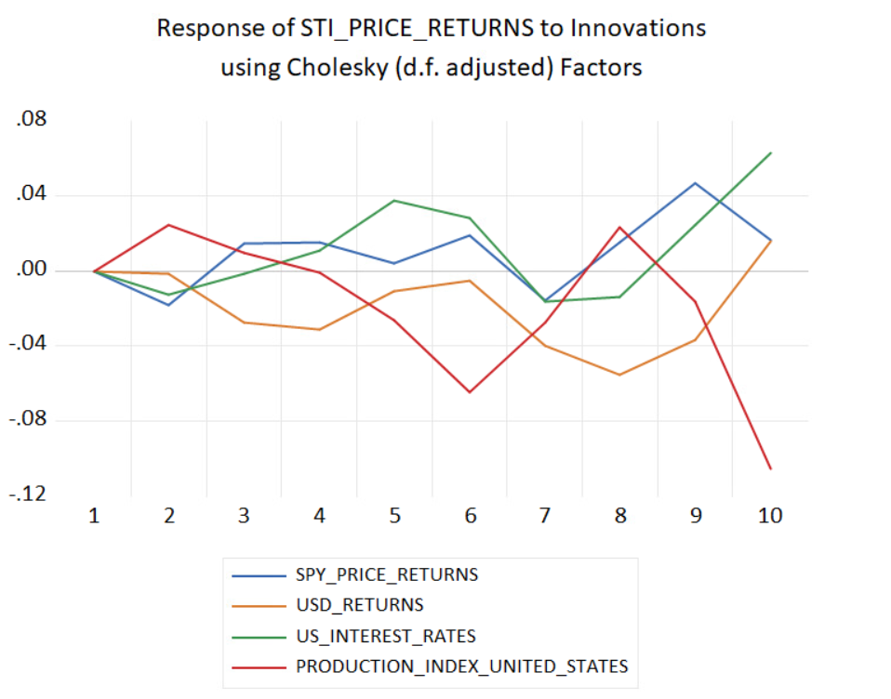
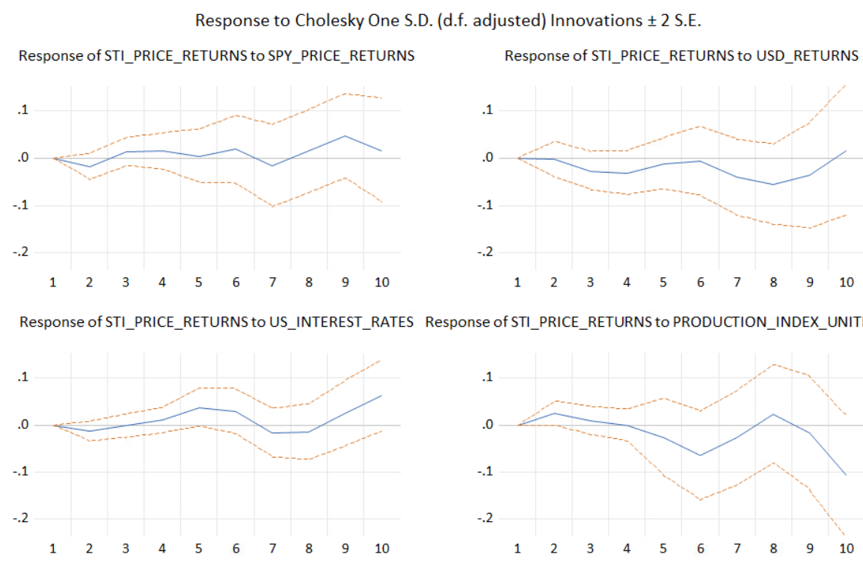
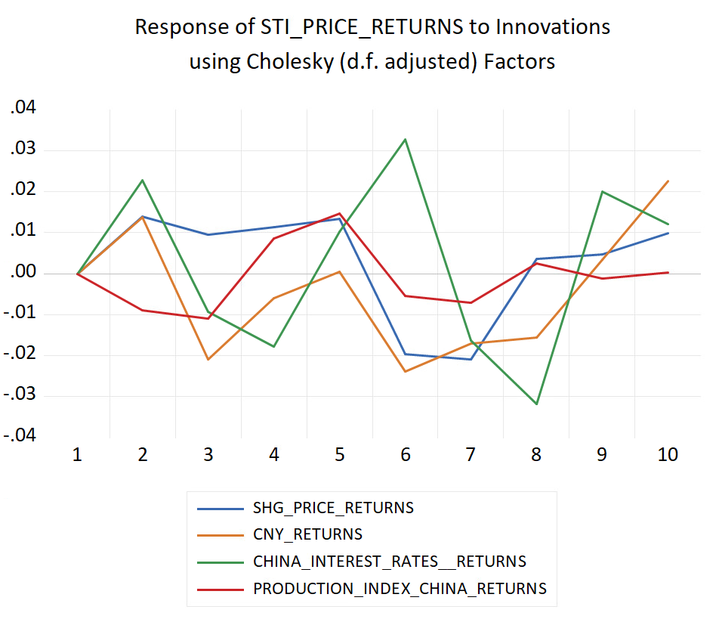
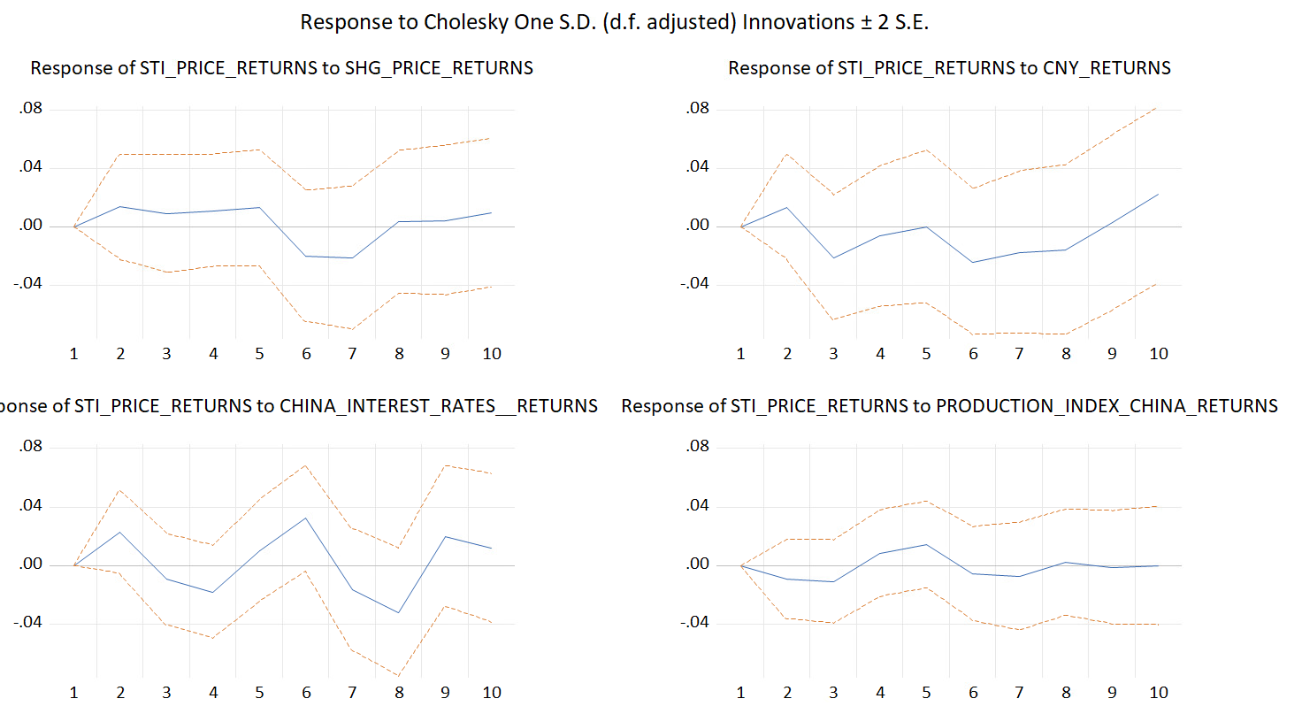
Research - VAR Analysis - Impulse Response

Slide 26
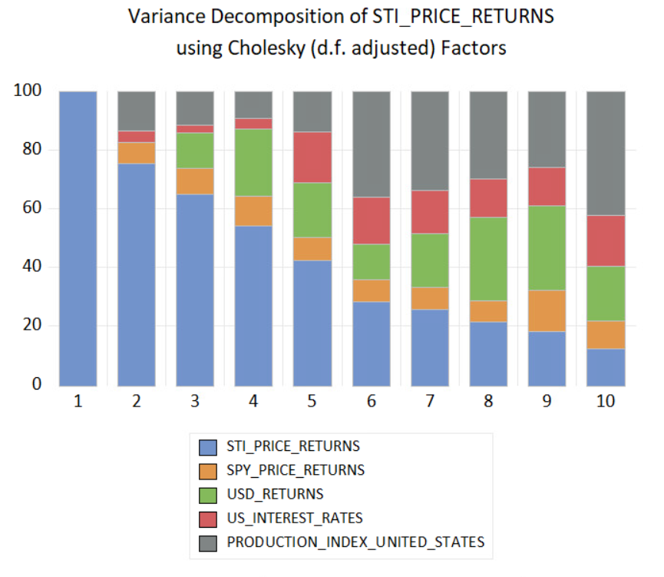
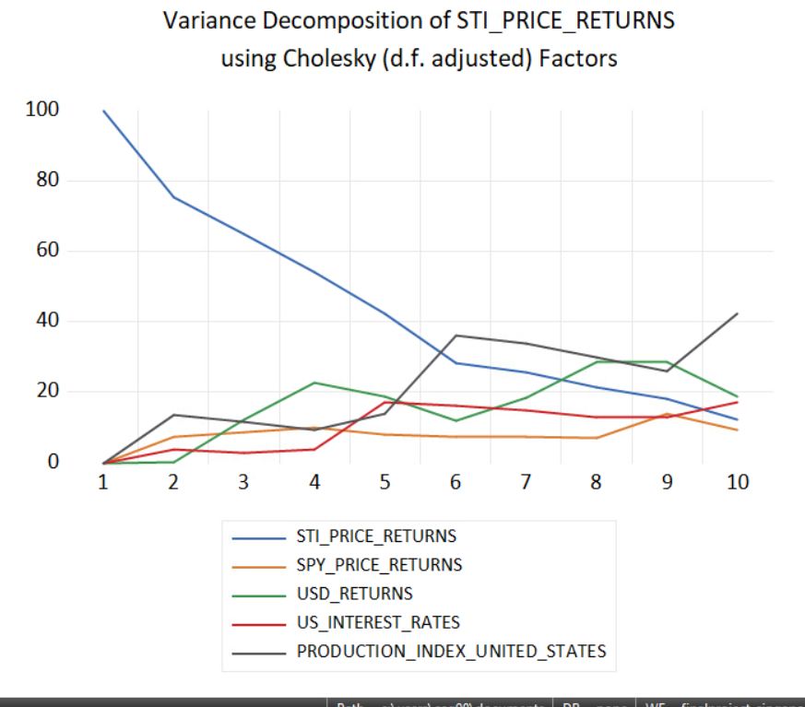
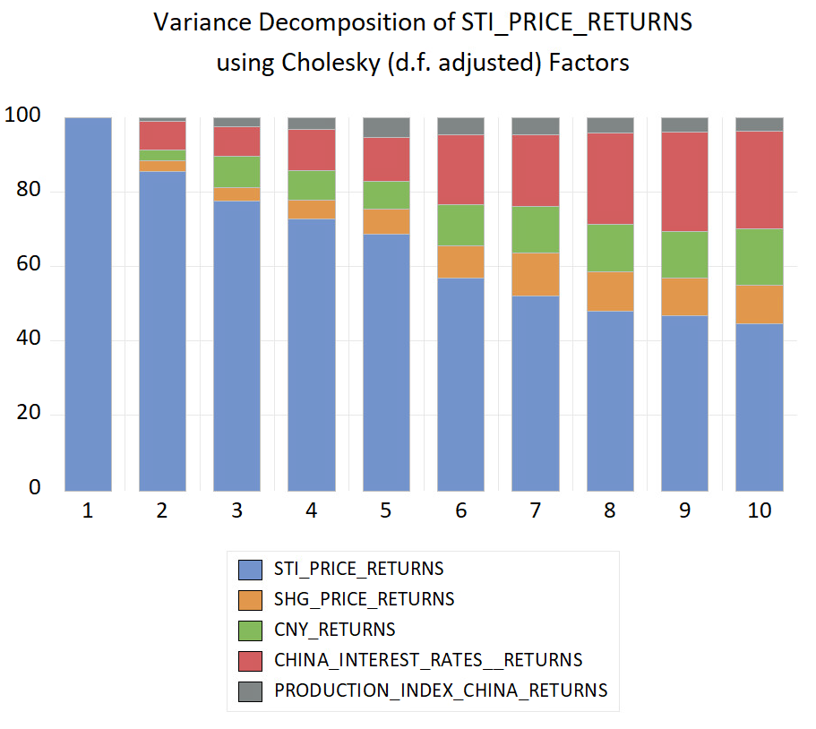
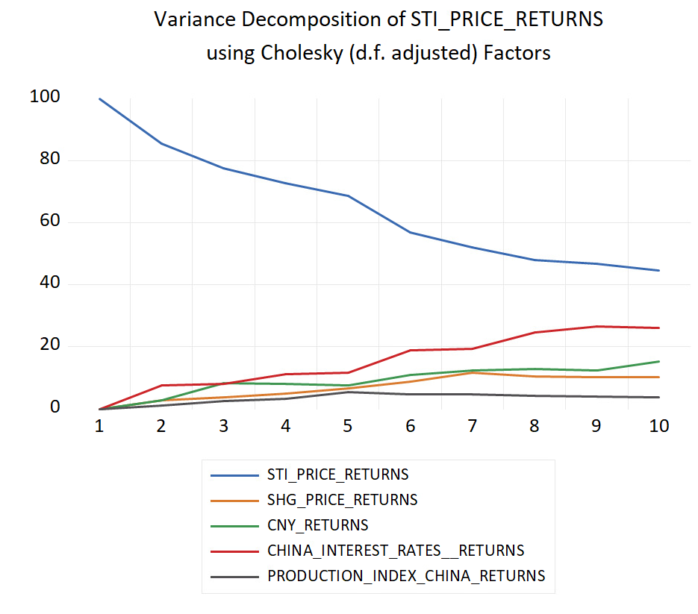
Research - VAR Model - Variance Decomposition

Slide 27
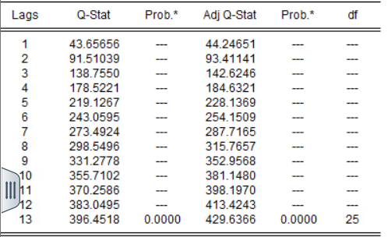
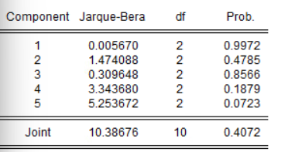
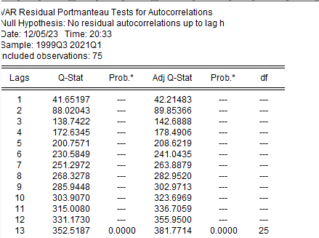
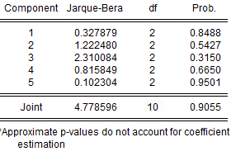
Research - Residual Analysis
Autocorrelation - Portmanteau Test
Normality Test Jarque Bera

Slide 28
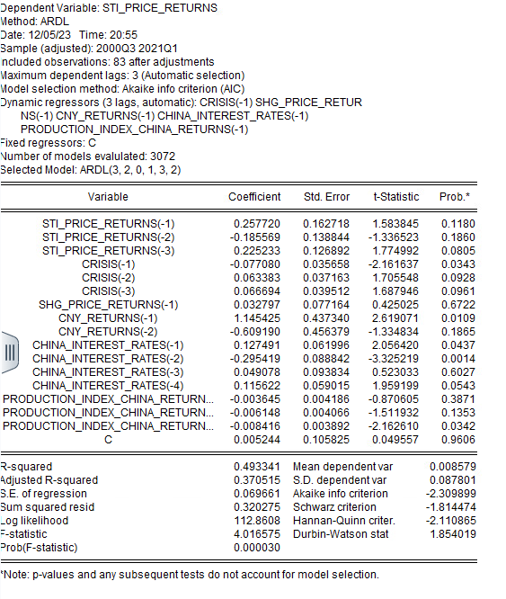
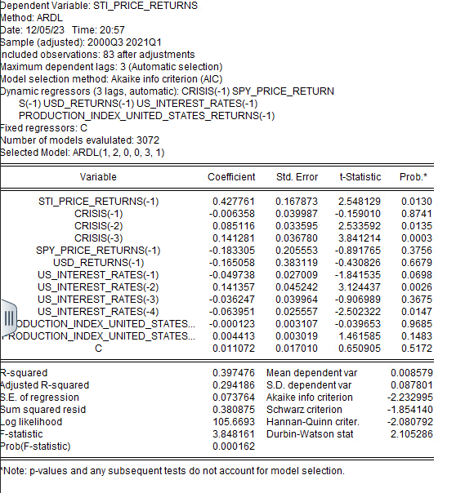
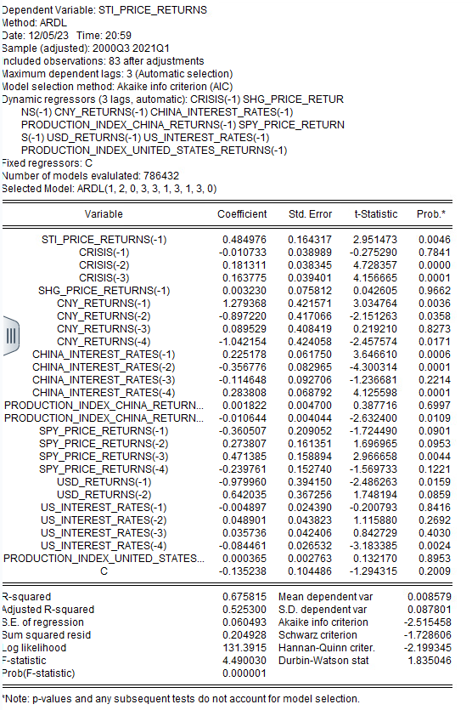
Research - ARDL(4) Model - Model Analysis

Slide 29
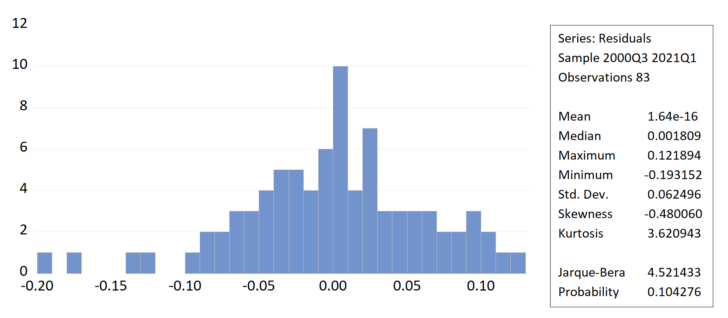
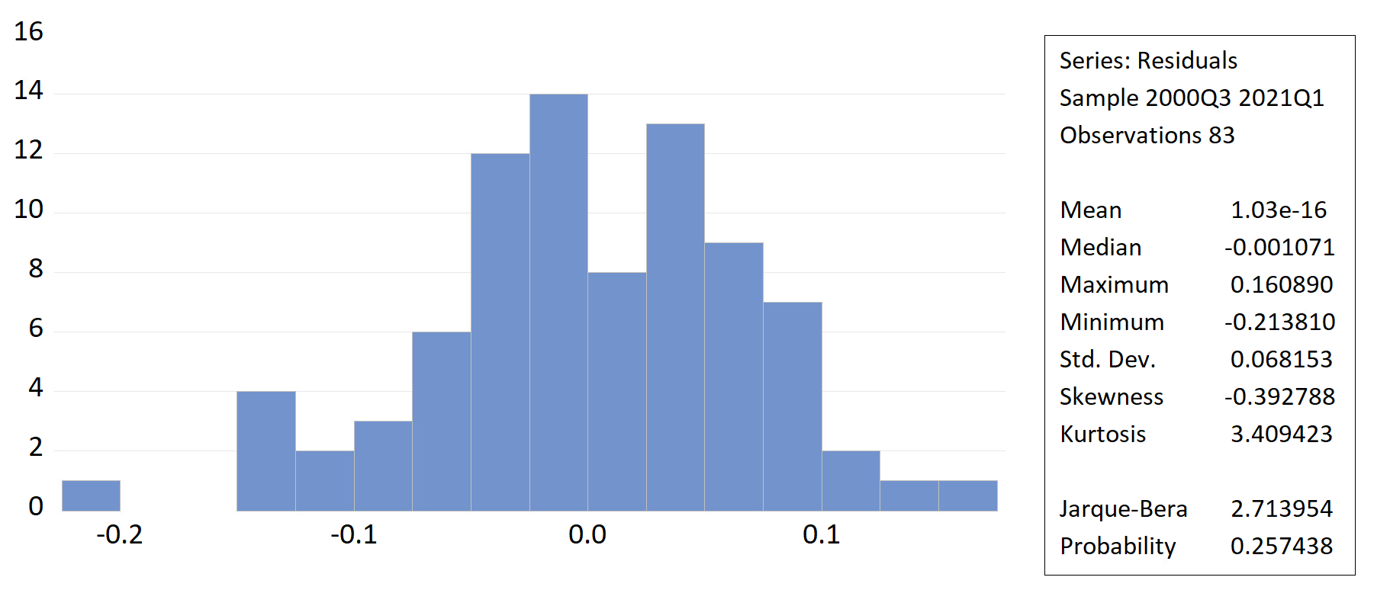
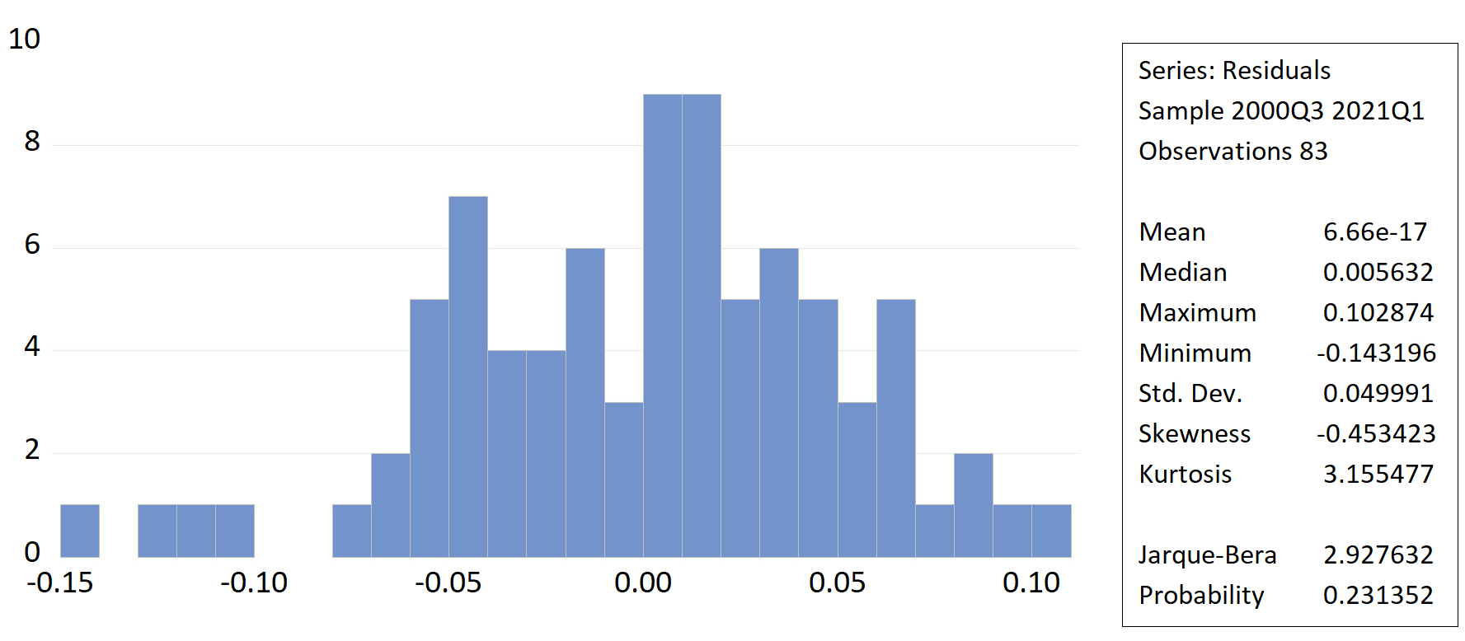
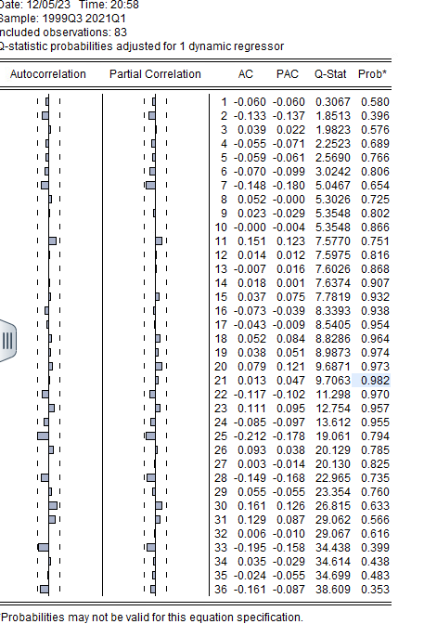
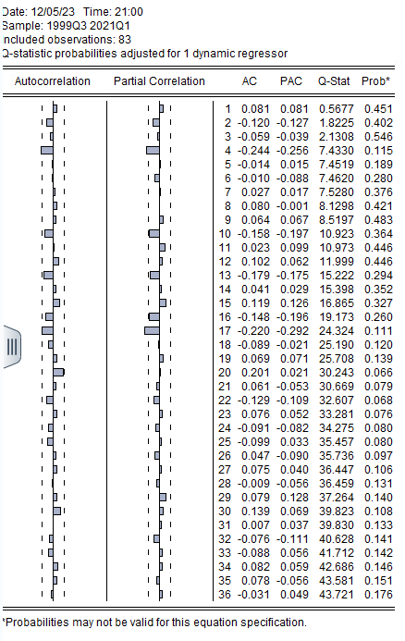
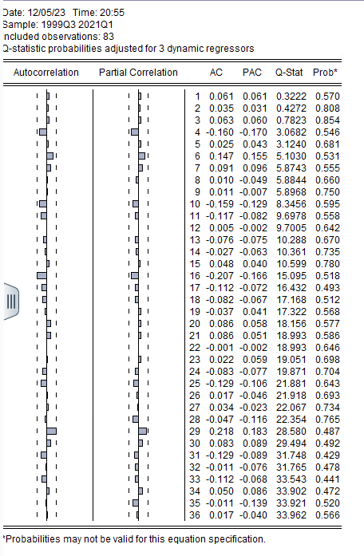
Research - ARDL Model - Residual Analysis

Slide 30
Research - Interpretation
Accept the null hypothesis: Due to the ARDL model having a stronger relationship from Chinese Economic variables & the US economic variables having a stronger short term variation than China. Therefore there is no conclusive evidence that China has a significantly stronger relationship even though it is arguably slightly stronger due to the models proposed here from ARDL & Cointegration.

Slide 31
Policy Implications

Slide 32
Policy Implications
Singapore should remain agnostic culturally & economically between these 2 superpowers and continue to split their growth off the backs of these superpowers.
Continue trade relationships and investment flows to each country.
Continue to stabilize culture to not favor one side or the other.

Slide 33
Future Research
Understand Economic Relationship between China & US between every Pacific & American Middle Economic Superpower

Slide 34
Bibliography
* Brunel University London - Stock Market Linkages between the Asean Countries, China and the US: A Fractional Integration/cointegration Approach - https://www.tandfonline.com/doi/full/10.1080/1540496X.2021.1898366
* Lowy Institute - Asia Power Index - https://power.lowyinstitute.org/
* Regional Responses to U.S.-China Competition in the Indo-Pacific (Singapore) - https://www.rand.org/content/dam/rand/pubs/research_reports/RR4400/RR4412z5/RAND_RR4412z5.pdf
* The influence of Chinese and US financial markets on Asia-Pacific - https://www.bis.org/publ/bppdf/bispap82i_rh.pdf

